Slide 1
Smart Contracts
An Overview

Slide 2
Presentation Plan
Introduction
Some Industry Use Cases
Implementation Scope in Airlines Industry
Benefits and Implementation Requirements
Integrating Artificial and Internet of Things Capabilities

Slide 3
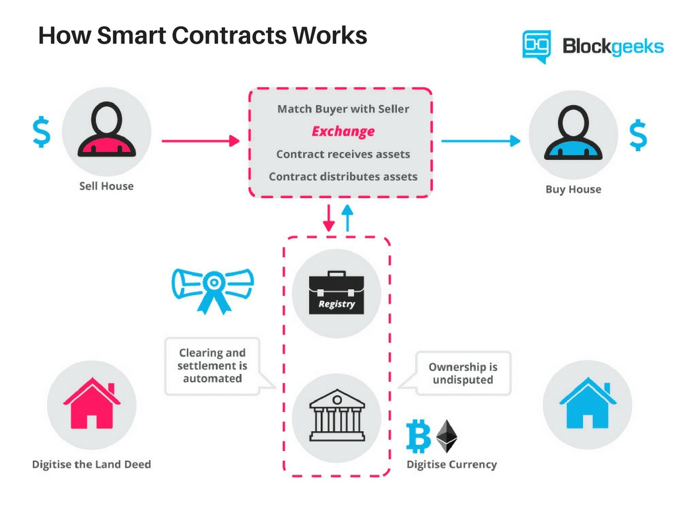
Introduction
A smart contract is a self-executing program that uses
Distributed ledger technology to store rules for a defined transaction, verify the request. And execute the agreed terms.
Smart Contracts allow the performance of credible transactions without third parties.
It is based on “Blockchain Technology”, which is one form of a secure, distributed ledger of transactions.
The source of the flow chart is www.blockgeeks.com

Slide 4
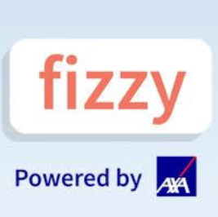



Some Industry Use Cases
The French Airlines and AXA, are taking flight insurance to the Blockchain, under the app name of Fizzy.
The insurance is based on a triggering event, e.g. if flight is more than 02 hours late, a customer will automatically notified with compensation options. The money is sent directly to accounts based on the selected option.
The Government of Dubai is testing distributed ledger technology for health records, land title transfer, business registration, tourist engagement and shipping.
SITA Lab carried out a research project with British Airways, Heathrow, Geneva Airport and Miami International Airport into ‘smart contracts’ residing on a Blockchain, called FlightChain.
Flight Chain, is devised to investigate a single source of truth for flight data to solve the “flight data problem”. It ensures all stakeholders have the same information.
Propy, is the first company to develop smart contracts for buying and selling real estate.
It facilitates “across-border” real estate marketplace allowing owners and brokers to list properties, where buyers can search and negotiate the sale. Title transfer is still sent through local authorities only.

Slide 5
Implementation Scope in Airlines Industry
Ticketing
Loyalty
Security & Identity
Maintenance
The Blockchain can tokenize the e-ticketing assets and further dematerialize it.
Using smart contracts associated with tickets, airlines can add business logic and terms & conditions around how the tickets to be sold and used.
This will open doors for tickets to be sold by different partners, and in real time, from anywhere in the world
By tokenizing loyalty points on the Blockchain, travelers can get instant value by redeeming them on the spot instead for waiting for a long time to get points settled and accrued to use them.
Points can be accepted as “currency” among more providers, travelers get an easier and faster-to-use programs.
Blockchain technology with a security wrapper can create a different and less risky way of managing and sharing this information through the use of authorized access requirements
Blockchain technology can transform maintenance logs, which are at best in cumbersome databases.
It can help the industry to ensure that parts procured are legitimate and can offer a “virtual copy”, including all details

Slide 6




Benefits and Implementation Requirements
Benefits
Implementation Requirements
Helps in creating trustworthiness between various parties within the sphere of work.
Moves from Central Authority to distributed system for faster processing.
Increases transparency of the transactions.
Reduces the number of intermediaries involved
Runs processes automatically
Choose a Blockchain platform that suits the business needs. Some platforms are Ethereum; Pythereum (Python implementation); Quorum; BaaS: Blockchain as a service by Microsoft based on Azure; Tierion, Embark, etc.
Design the nodes, APIs, take care of hardware and all the required configurations.
Define the rules and conditions that must be outlined in smart contracts.
Test the contracts to make sure they contain no mistakes and vulnerabilities.

Slide 7
Integrating AI and IoT Capabilities
Artificial Intelligence
Internet of Things
AI can analyse past negotiations to see how parties negotiated in the past suggest type of language and clauses most likely to secure agreement.
AI can also analyze past contracts to identify variables not previously considered, and incorporate them into future contracts.
AI solutions can be developed in Python or Microsoft Azure, and can be implemented as APIs or to define rules.
IoT can facilitate the sharing of services and resources leading to creation of a marketplace of services between devices.
IoT can allow to automate in a cryptographically verifiable manner several existing and time-consuming workflows.

Slide 8
Thank You

